Slide 1


Research Topics in Blockchain
&
Blockchain and Its Application
Lecture # 3: Centralize Security
Concept

Slide 2
Cryptographic primitive
Hash Functions
Public Key cryptography
Data Structure for Security

Slide 3

Public Key Cryptography

Slide 4
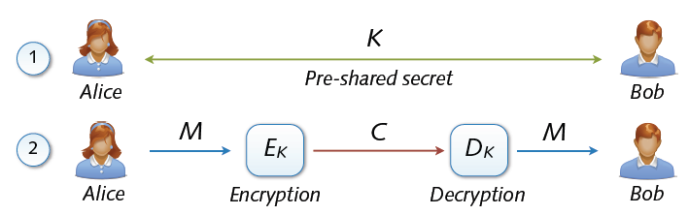
Symmetric cryptosystems
Precondition: secure exchange of keys in advance
  Paradox situation at a first glance
  secure communication depends on secure key exchange
1.Required Keys
2.We Require Many keys
3.Concept of Digital certificate

Slide 5
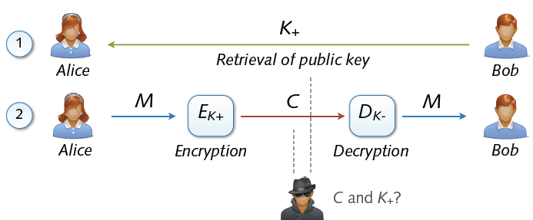
Asymmetric Cryptosystem
Asymmetric cryptosystems
  Asymmetric encryption and decryption
  K+ (pk) = public key of Bob K– (sk) = secret key of Bob
  No secure key exchange necessary

Slide 6
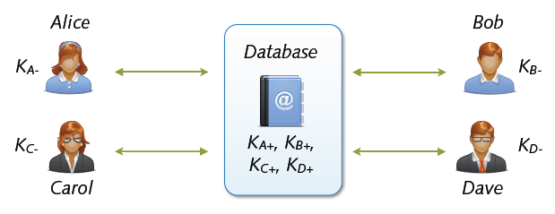
Key Exchange with Public Keys
Scalable communication with multiple parties
  Linear number of exchanges: n parties → n public keys
  Real-world systems with millions of keys (e.g. PGP)
  ... for the moment everything is fine
Hack

Slide 7
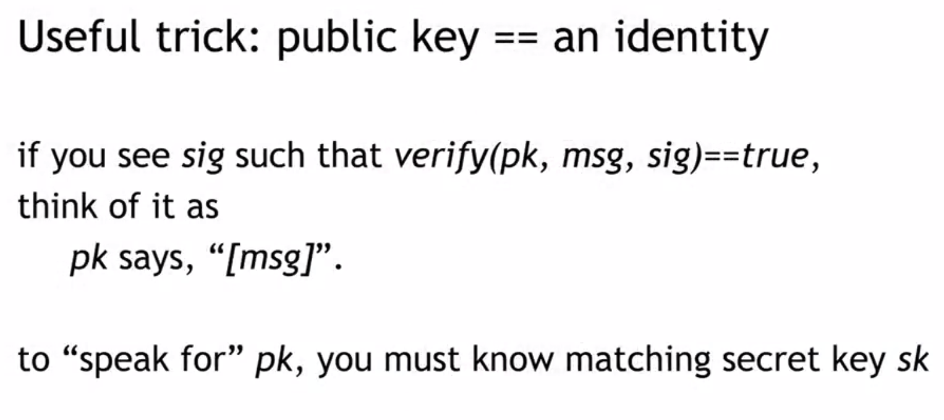

Slide 8
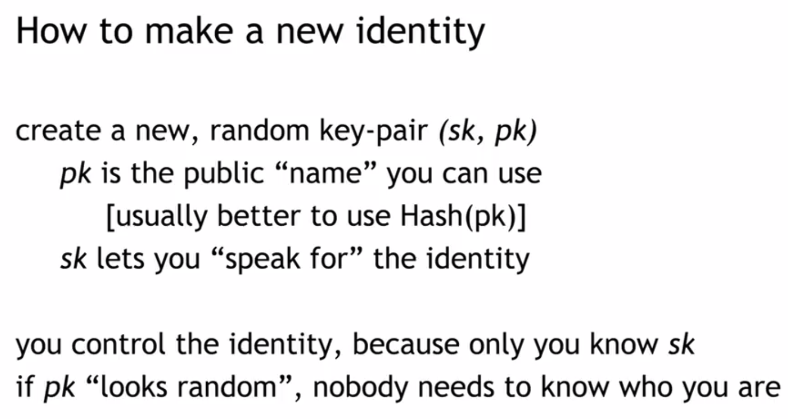

Slide 9
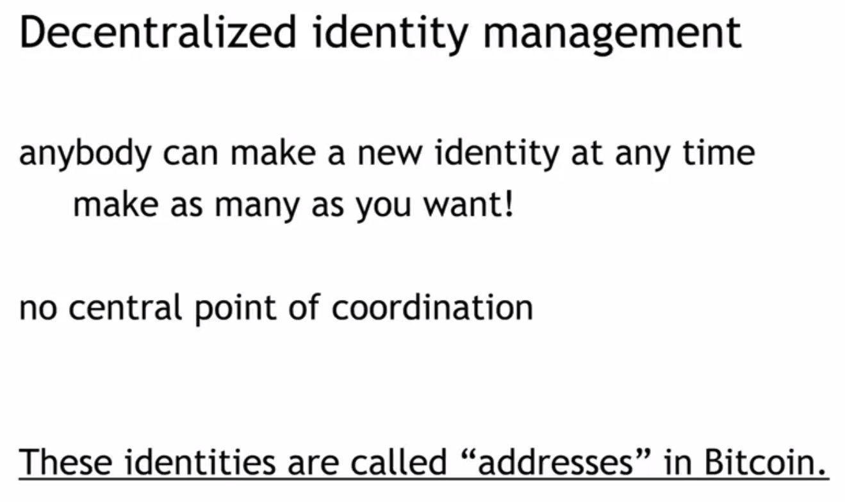

Slide 10
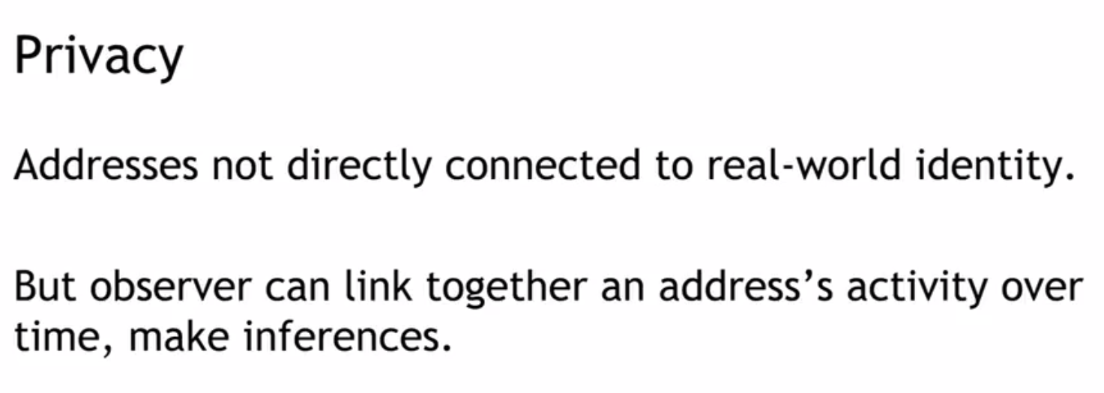

Slide 11
Digital Signatures

Slide 12
Digital Signature
Authentication and Non-Repudiation
  Gives a recipient reason to believe that the message was created by a known sender such that they cannot deny sending it
Integrity
  The message was not altered in transit
Notes:
Non-repudiation refers to a state of affairs where the purported maker of a statement will not be able to successfully challenge the validity of the statement or contract

Slide 13
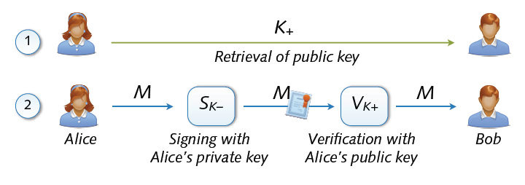
Digital Signature
Digital signing: reverse application of public-key system
  Signing = encryption with private key
  Verification = decryption with public key

Slide 14
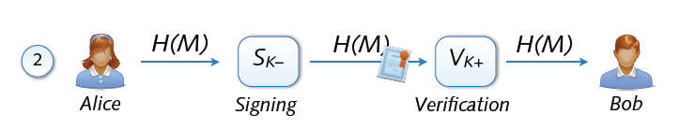
Signing and Hashing
Encryption and decryption of large messages inefficient
  Signing of hash H(M) instead of message M
  Verification of message M using signed hash H(M)
  One-way property: hard to find M’ with H(M’) = H(M)
  Support for signing emails, images, videos, ...

Slide 15
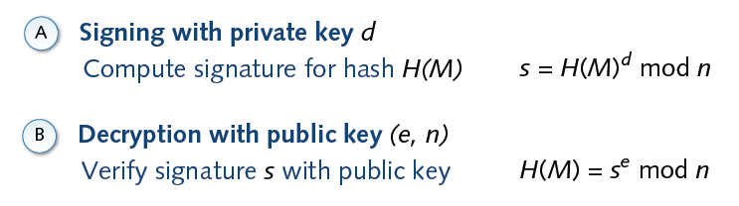
Signature and RSA

Slide 16
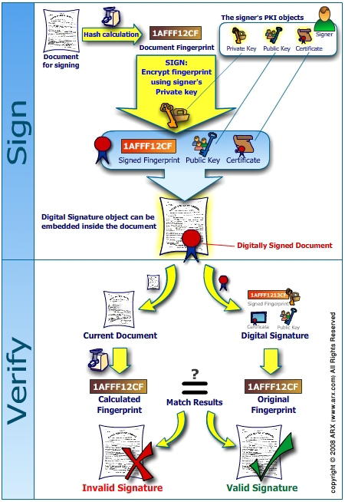
`

Slide 17
Data Structures for Security
Data structures play a significant role in implementing secure systems by organizing and managing data efficiently while ensuring confidentiality, integrity, and availability. Here are key data structures commonly used in security applications:
Linked List , Array , Tree , Binary Tree , Merkel Tree ……

Slide 18
Linked List in Security
A linked list is a linear data structure where each element (node) contains data and a reference (or pointer) to the next node in the sequence. From a security perspective, linked lists can be utilized in scenarios where dynamic and flexible memory management is critical.
Imagine you're managing a system for tracking student activities in a secure and tamper-proof way. For example, each time a student completes a quiz, submits an assignment, or participates in a club activity, you want to record that activity. You also want to ensure that no one can tamper with the records, ensuring the integrity of the data.
Here's how the system works:

Slide 19
Pre Next
Pre Next
Pre Next
Pre Next
Data 1
Posted By
A1
Data 1
Posted By
A2
Data 1
Posted By
A1
Data 1
Posted By
A3
Challenge -1
A1 can its data only
A2 can see its data only
A3 Can See it data
Challenge -2
Public and private Keys mechanism
Challenge -3
Who is responsible to maintain the address of Linked List
Solve with filtering and conditional checks

Slide 20
Solution-1
Make independent Linked List of each clients
Solution-2
Public key and private key
Is used for interaction
Transaction is recorded in
Each linked List
Solution-3
Linkned list address is generated automatically
Which may be deducted in some scenario

Slide 21
Research Topics in Blockchain
&
Blockchain and Its Application
Lecture # 4:
Hash Pointers and
Merkel Tree

Slide 22
Hash Pointers
Temper evident Logs task
Challenges in Linked List
Binary Tree
Merkel Tree Concept
Proof of Membership in Merkel tree

Slide 23
Hash Pointer and Data Structures

Slide 24
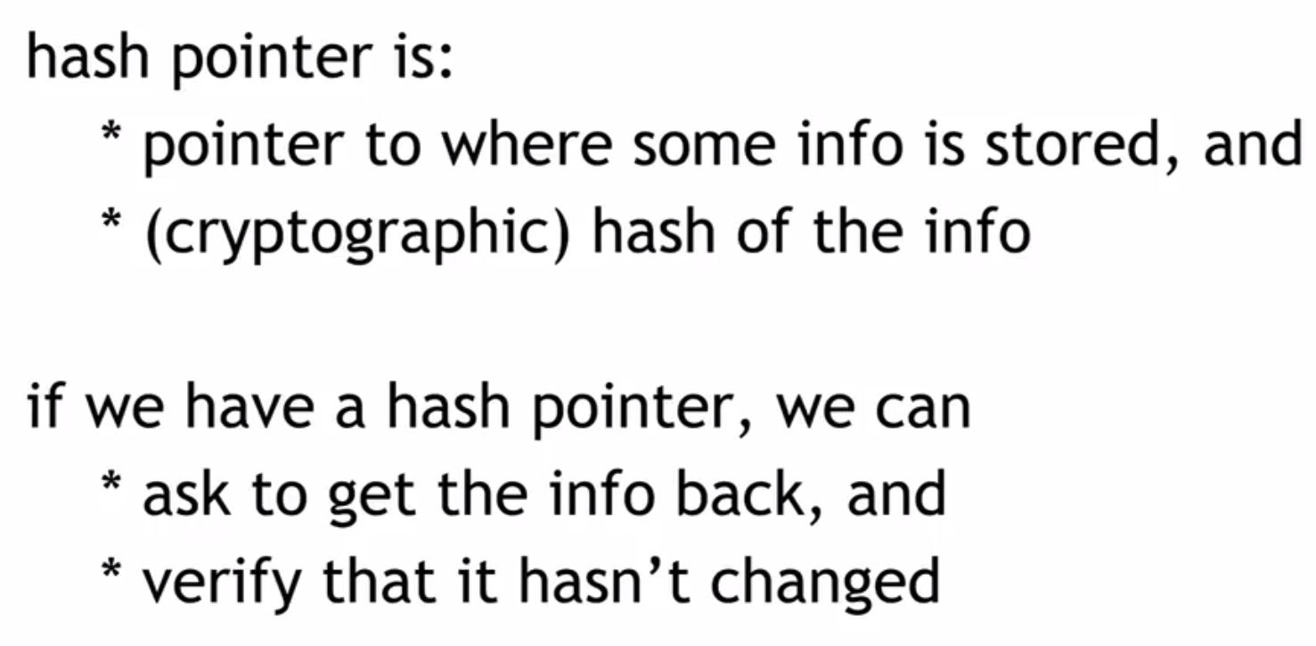

Slide 25
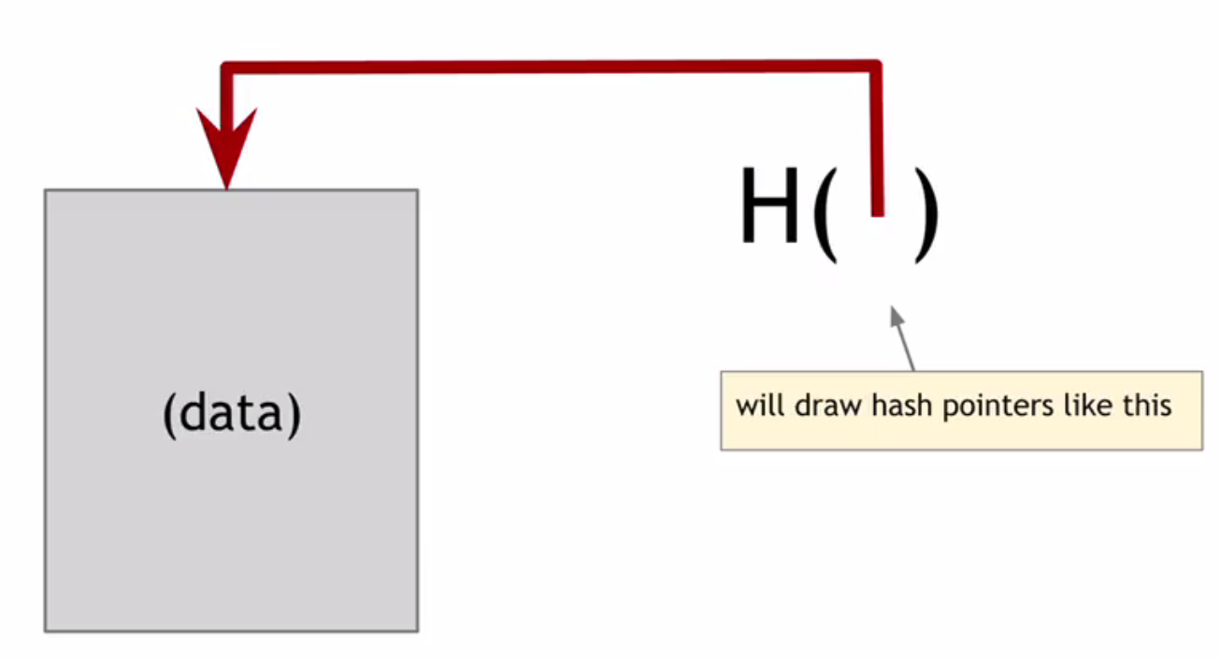
Signature
ABCF123
Signature
1000020003040

Slide 26
Your task is to design and implement a tamper-evident log system using the concept of a linked list with cryptographic hashes. You will create a data structure that maintains the integrity of logs and detects tampering automatically. The challenge is to construct the solution from scratch by completing the steps provided below.
Challenge Details:
Scenario:
Imagine a system where logs are critical, such as financial transactions, system events, or audit trails. If any log entry is tampered with, it should be detected immediately by verifying the hash links. Your goal is to implement this system and test its tamper-resistance.

Slide 27
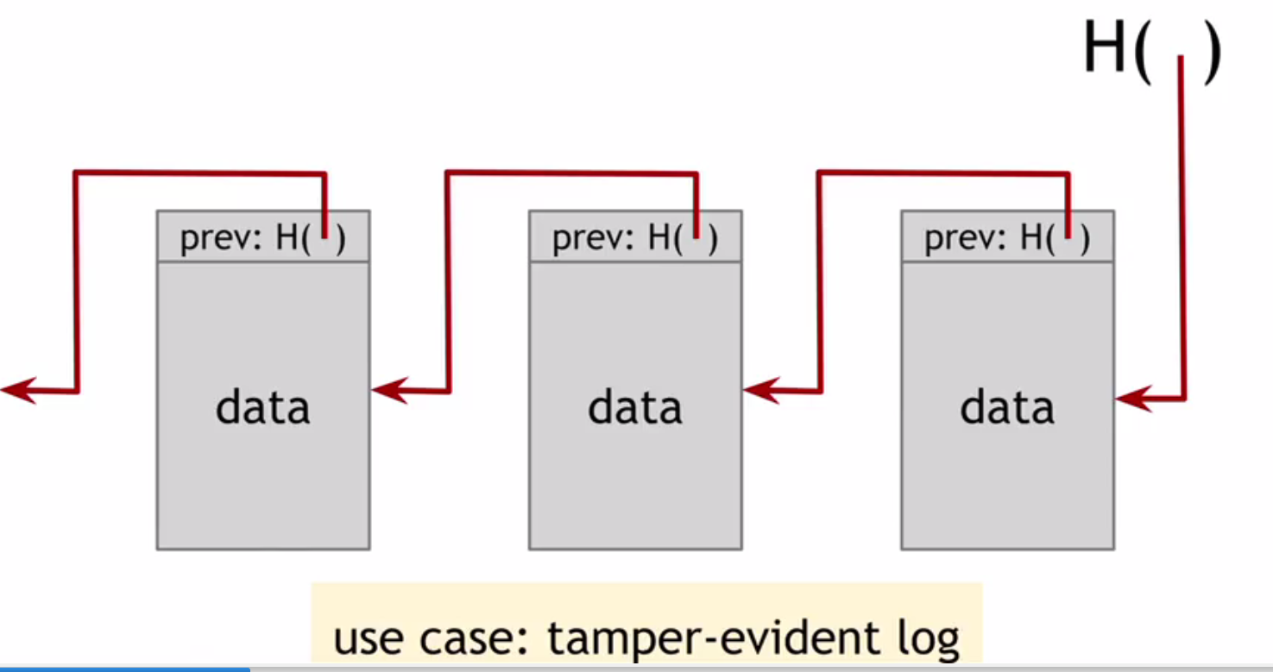
Tamper-evident Log
A tamper-evident log is a data structure or system designed to ensure that any unauthorized modification to the logged data can be easily detected
ABCF123
ABCF122
ABCF125
ABCF124
Signature
1000020003042
Signature
1000020003041
Signature
1000020003040
Key feature of Blockchain

Slide 28
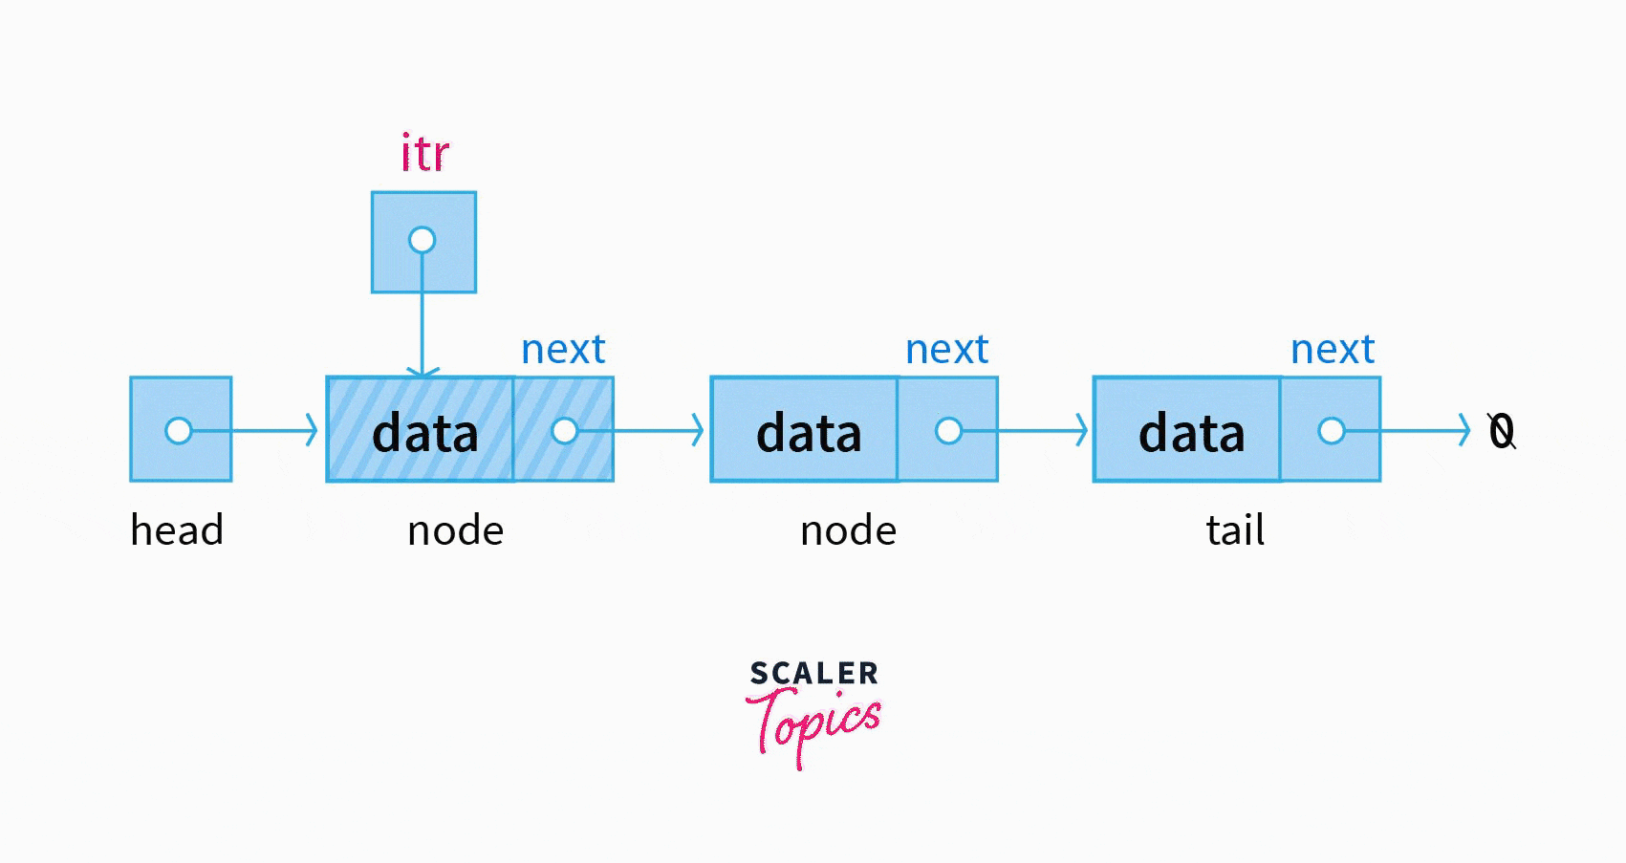
1.Know How security is embed in Linked list data structure
2.How data is secure through
Public key and private key
3.How Hash is used for Temper evident Prospective
Challenges
.
Linked lists are a common data structure in data engineering, as they allow for dynamic and flexible insertion and deletion of elements. However, they also have some drawbacks, such as slow access and traversal, memory overhead, and potential fragmentation

Slide 29
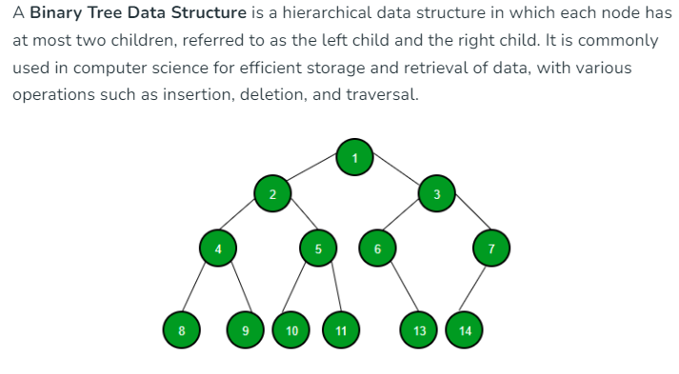
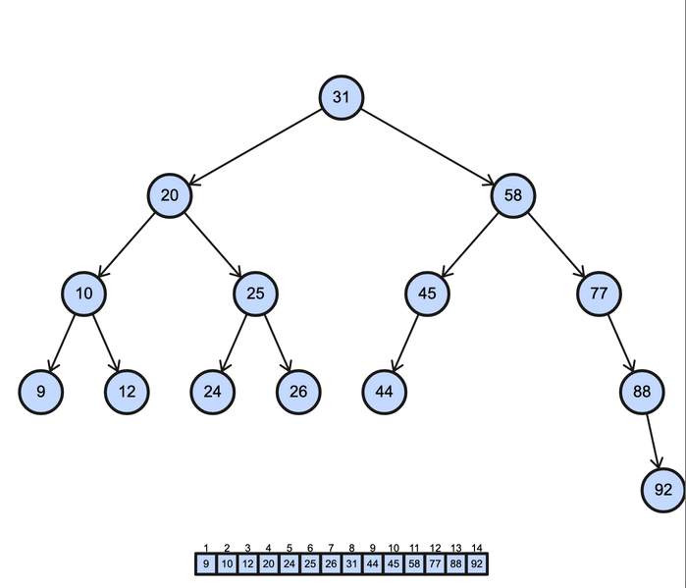
Binary Tree in Security
1.How data is store Like in the linked List
In Binary tree

Slide 30
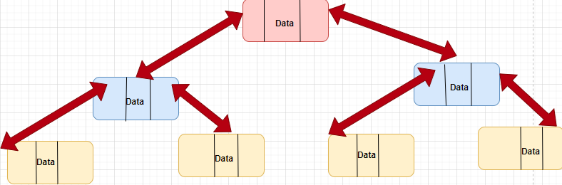

Slide 31
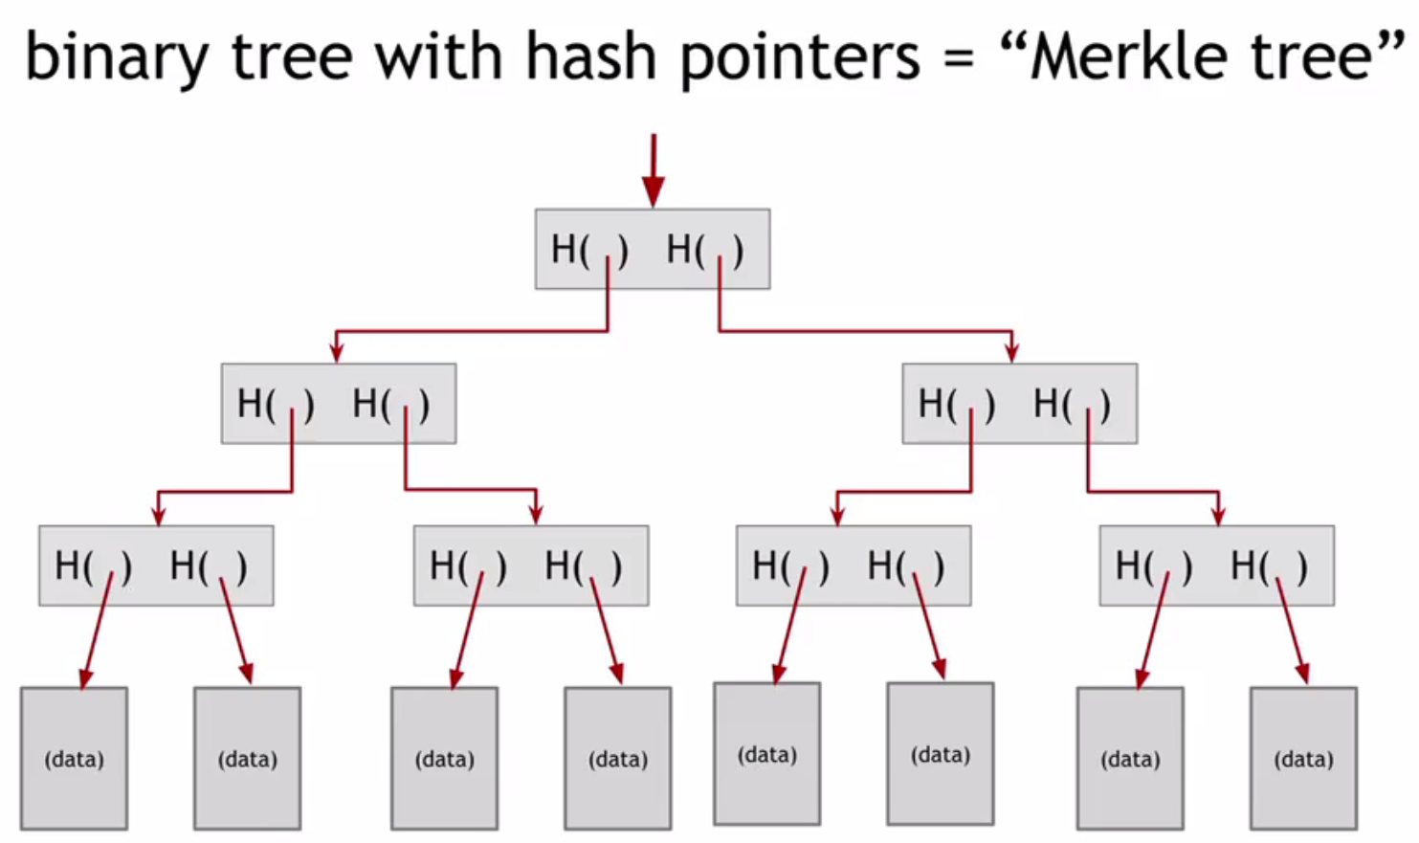
Merkel Root .
??
The genesis block is the first block in the blockchain and is predefined when the blockchain is initialized.
125
??
123
124
125
??

Slide 32
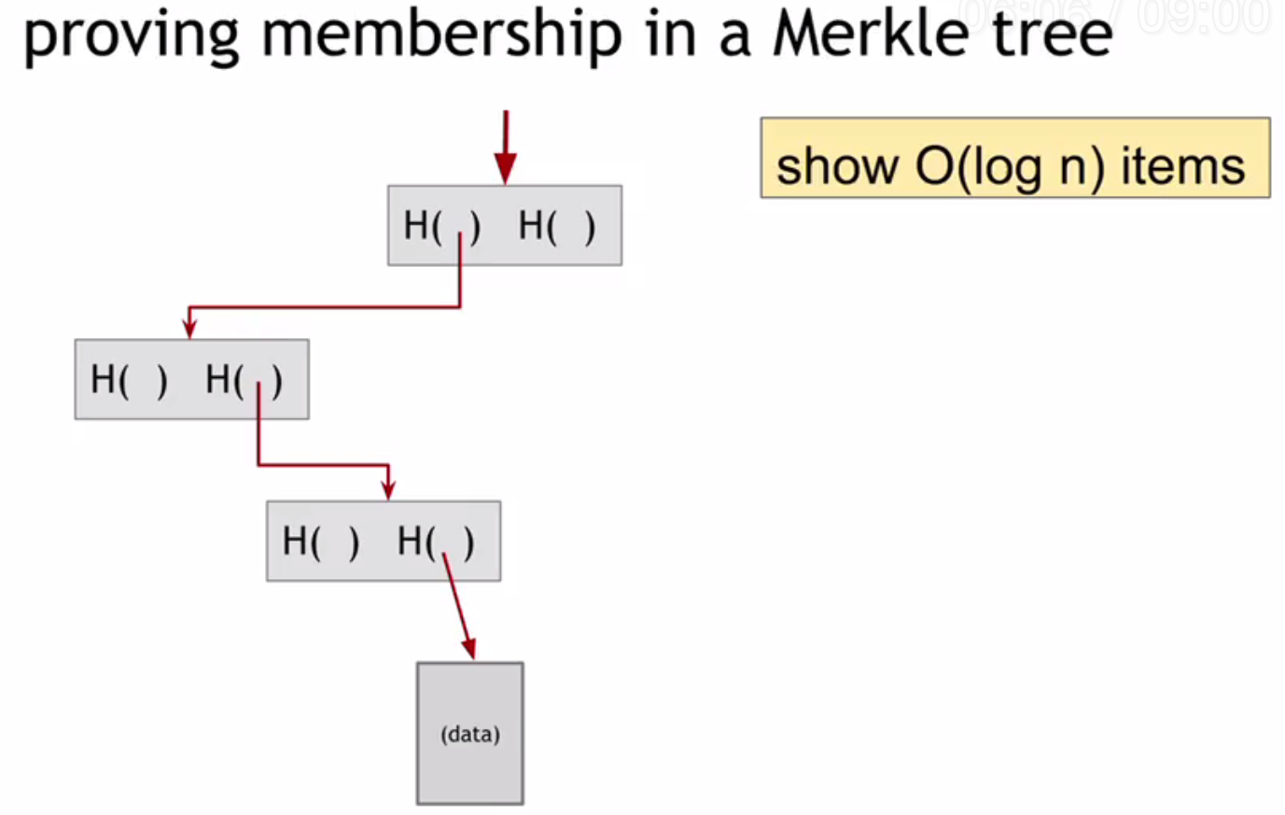
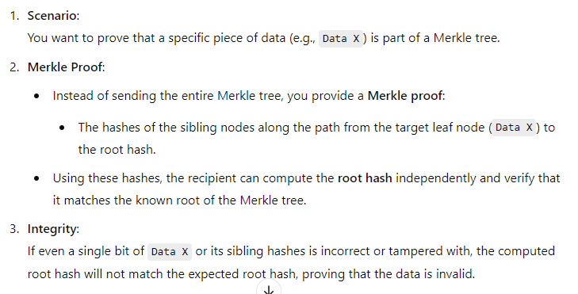

Slide 33
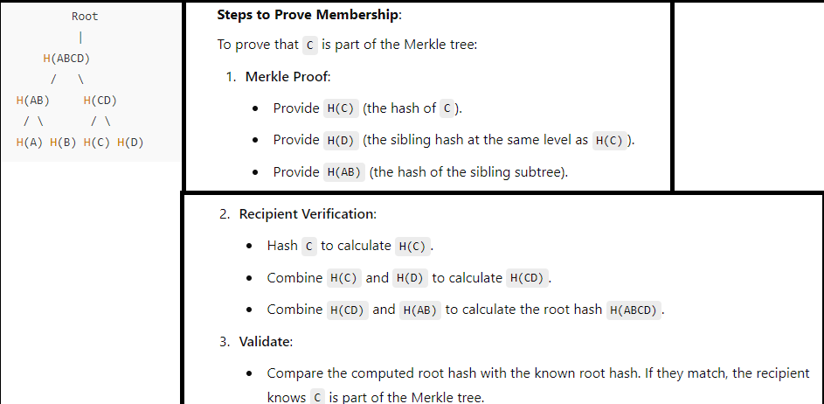
In blockchain, a proof of membership is used in scenarios where you need to verify that a specific transaction, record, or data point exists in a block without downloading or exposing the entire blockchain. This ensures efficiency, privacy, and integrity of the data.

Slide 34
Block Structure and BlockChains

Slide 35
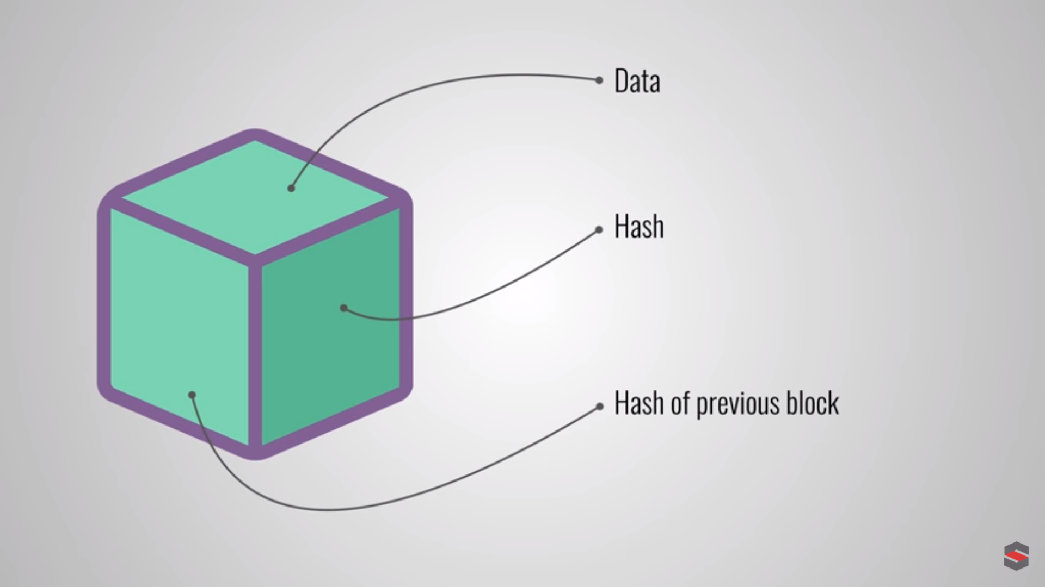

Slide 36
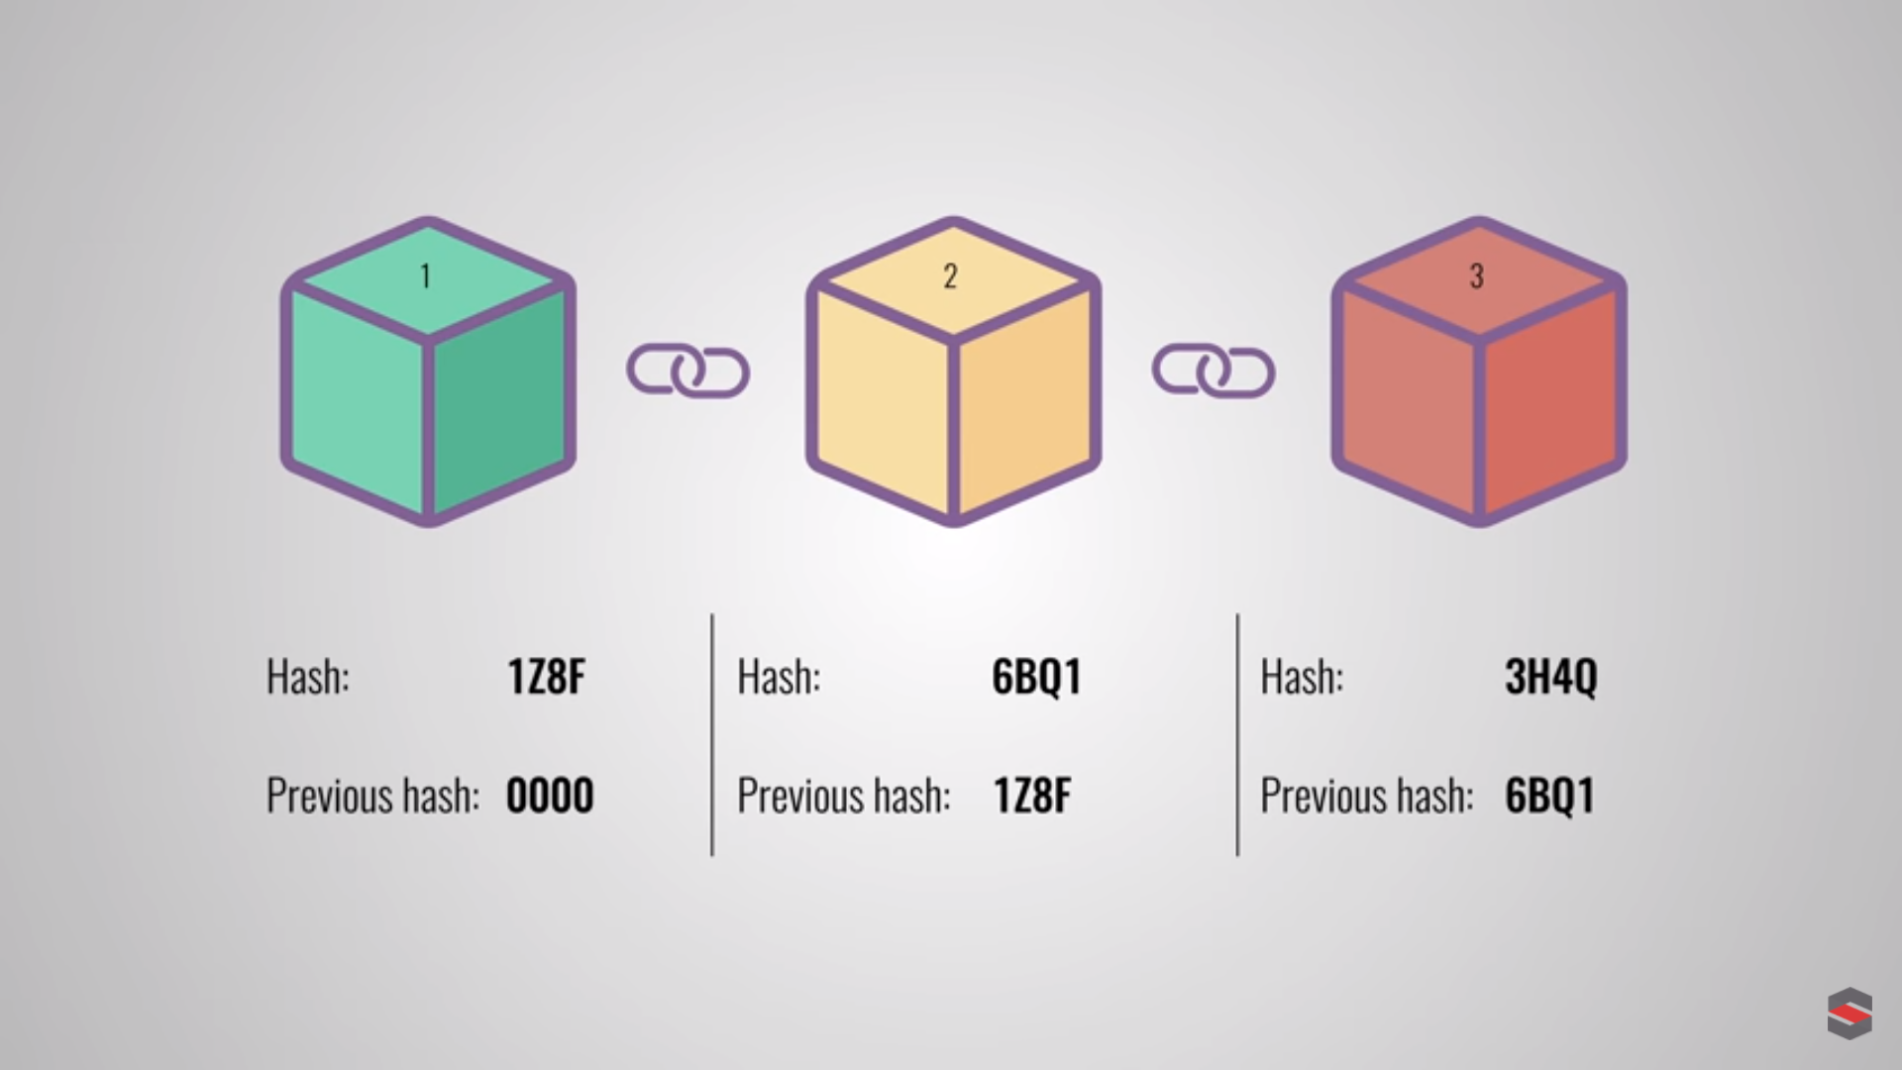

Slide 37
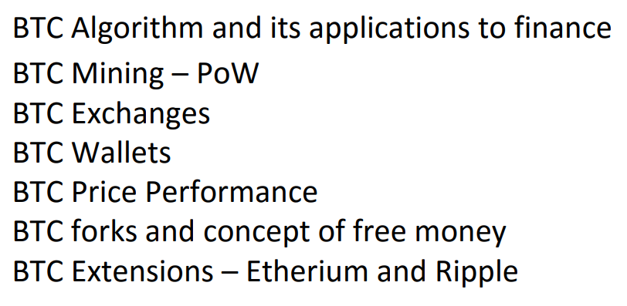

Slide 38
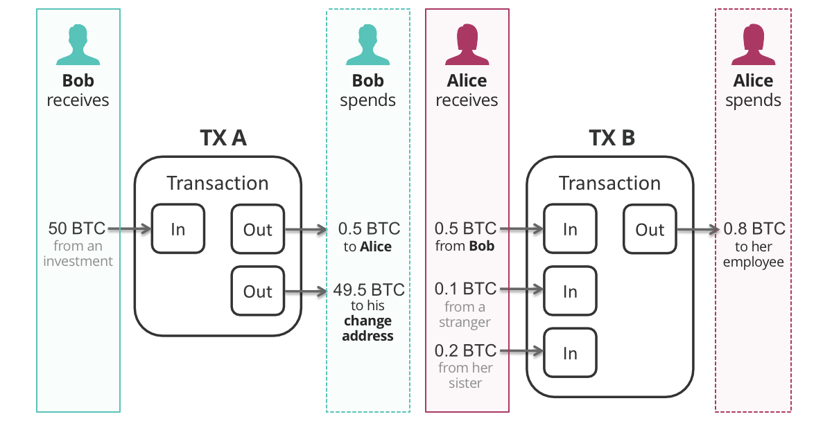
Wallet of Bob in which receive and spend ledger is
Created

Slide 39
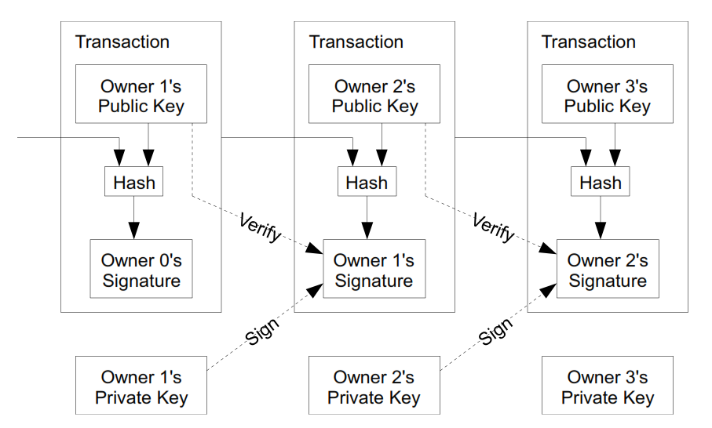
A(10)(Alice Signature)
Encrypt with Public Key (B)
Transactional
Hash
Alice (10) Private
Signature
A->B
Alice represent as 0
Bob represent as 1
Verify the signature Hash through Public Key of A Decryption Process
Verify the signature Hash through Public Key of 0 Decryption Process

Slide 40
Research Topics in Blockchain
&
Blockchain and Its Application
Lecture # 5:
Goofy Coin

Slide 41
Cryptocurrency Basics
Goofy Coin
Workflow of Goofy Coin
Digital Transaction
Challenges
Task-1 , Task-2 , Task-3

Slide 42
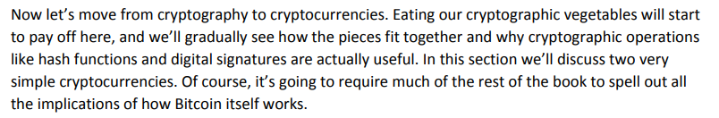
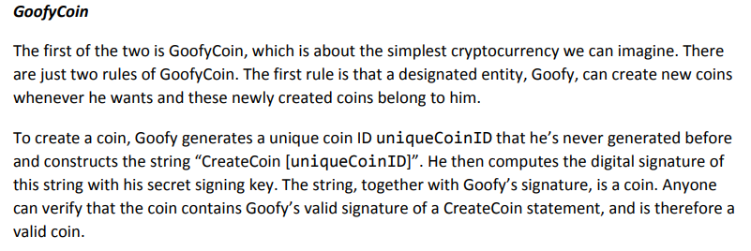

Slide 43
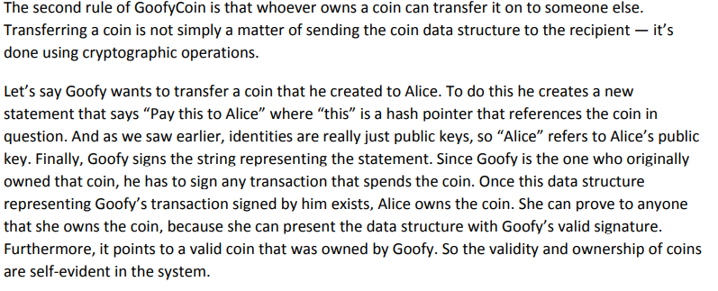

Slide 44


1.Generate Goofy Coin
2.Pay to [Alice]
3.Sign the
Transaction

Slide 45
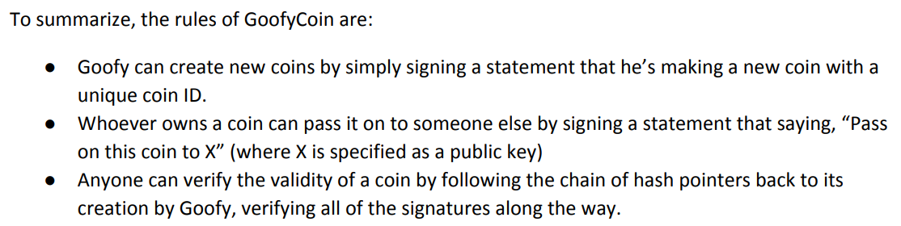
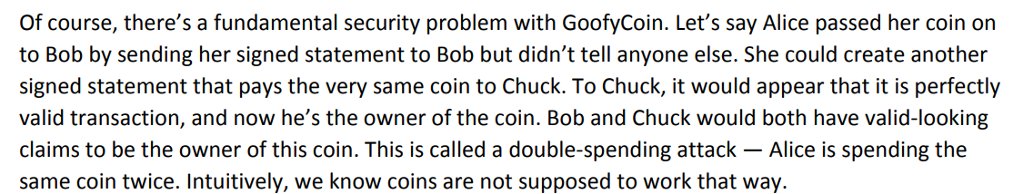

Slide 46
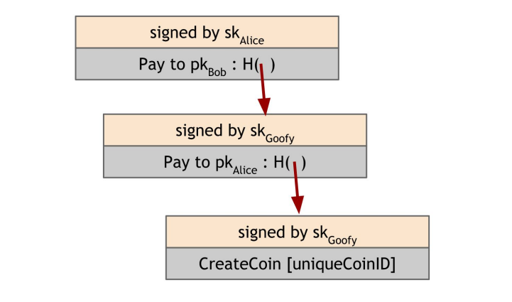
Coin->
Singed by Alice
Coin->B
Singed by Goofy
Coin->A

Slide 47
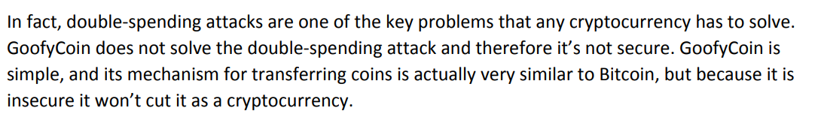

Slide 48
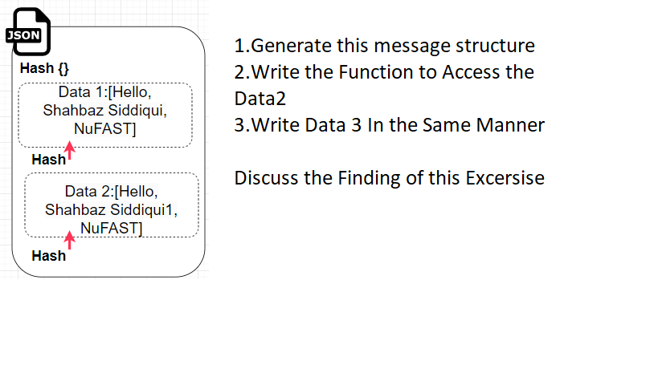
Task-1 With Client Server Program having 2 Client A and B and Server
Sending Message: A->Server A->Server->B B ->Server->A
Task-1 With Client Server Program
Group Task
Marks 0.5
Focus :Implementation of Data immutability also Verification of this Concept, No use of encryption of data is used

Slide 49
Task-2 Implement the concept of Goofy Coin
Sending Message: A->Server A->Server->B B ->Server->A
Group Task
Marks 0.5
Focus :Implementation of Goofy Coins
Rules Such as Create Coin Pay to script

Slide 50
Task-3 Implement the concept of double Spending Problem
Focus :Implementation of Goofy Coins
Rules Such as Create Coin Pay to script

Slide 51
Discussion of Findings

